Slide 1
Understanding Conformance Testing Using the NIST HL7 v2 LRI-LIS Validation Tool
Conformance Criterion:
Transmit electronic laboratory tests and values/results
Robert Snelick, NIST (rsnelick@nist.gov)
V1.2 November 16, 2016

Slide 2
Purpose
Provide an additional resource to explain the process of HIT Module conformance testing related to HL7 v2 Laboratory Results Interface-Laboratory Information System (LRI-LIS) Messaging
Describe NIST approach for assessing and validating the test messages
Provide an overview of the testing requirements

Slide 3
Table of Contents
List of Resources
Scope of Conformance Testing
Transmit electronic laboratory tests and values/results criterion and conformance standards
Testing Process Diagram
Testing Workflow Diagrams
Explanation of Test Scenarios and Test Cases/Steps
Example Test Step Documents
Explanation of Test Data Categorization/Validation
Test Tool Overview and Example Test Tool Screen
Additional Resources

Slide 4
Resources
Test Tool Web Site (http://hl7v2-lab-r2-testing.nist.gov/lri-r2/#/home )
Validation Tools
User Documentation
Normative Test Process Document (on Test Tool Documentation Tab)
S&I Framework Lab Results Interface (LRI) Implementation Guide
(http://www.hl7.org/implement/standards/product_brief.cfm?product_id=279)
LRI-LIS Tool Quick Reference Guide (In Process)
LRI-LIS Tool Tutorial (In Process)
Release Notes for each version of Test Tool
(on Test Tool Documentation Tab)
LRI Test Tool Google Group for submitting questions to the Test Tool developers Same url is used for ONC 2014 Edition LRI Test Tool
(https://groups.google.com/d/forum/hl7v2-lab-testing)

Slide 5
Scope of Conformance Testing - LRI-LIS
Testing is directed at a Health IT Module (product), not specific instances (installations) of the Module
The conformance criterion is focused on testing the capability of an HIT Module (e.g., LIS or EHR-S lab module) to create HL7 messages for electronic transmission of clinical laboratory test results
Site-specific configuration of the HIT Module is not being tested
Method of transmitting the result messages is not being tested
Testing focus and scope are narrow
Testing encompasses only specific use cases described in the LRI Implementation Guide (IG)
Testing does not attempt to address the entire spectrum of use cases found in practice
How the LRI messages are transmitted/exported from the HIT Module is out of scope
Receiving EHR-S are not being tested using the LIS Test Plan in the LRI Test Tool (receiving EHR-S are being tested using the EHR Test Plan in the LRI Test Tool)
HIT Module conformance testing is driven by the test data
The HIT Module is required to demonstrate the ability to create HL7 v2 lab result messages for electronic transmission; specific test data for the messages are provided in Test Cases
The test data and Test Cases do not cover all possible clinical lab tests; through consultation with clinical laboratory experts, a subset of key lab tests were selected for testing
The format in which the test data are displayed on the screen of the HIT Module is not part of the testing
Clinical laboratory subject matter experts, in collaboration with the National Institute of Standards and Technology (NIST), provided the Test Scenarios, Test Cases, and Test Data for the Laboratory Results Interface (LRI) conformance testing

Slide 6
Conformance Criterion - LRI-LIS
Transmit electronic laboratory tests and values/results testing evaluates the capability for an HIT Module to create laboratory test values/results messages using
HL7 Version 2.5.1 Implementation Guide: S&I Framework Lab Results Interface, Release 1, DSTU Release 2 – US Realm, September 2015 (Referred to as LRI IG)
LOINC® version 2.50

Slide 7
Conformance Standards - LRI-LIS
Electronic incorporation and transmission of lab results
HL7 Version 2.5.1 Implementation Guide: S&I Framework Lab Results Interface, Release 1, DSTU Release 2 – US Realm, September 2015
Vocabulary for representing electronic health information
Logical Observation Identifiers Names and Codes (LOINC®) Database version 2.50, a universal code system for identifying laboratory and clinical observations produced by the Regenstrief Institute, Inc.

Slide 8
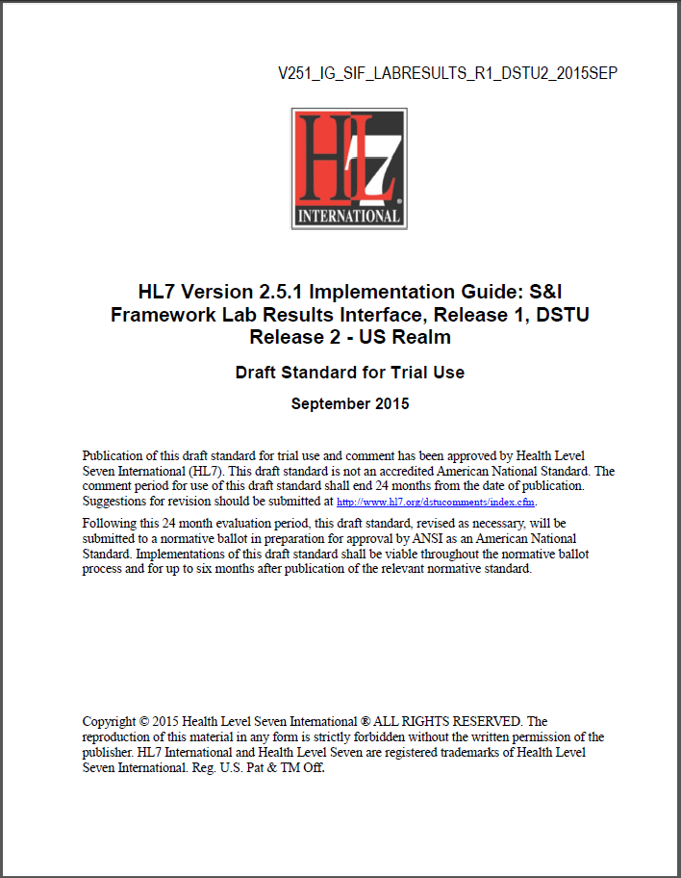
Conformance Standards Documents – LRI-LIS
HL7 v2.5.1 LRI Implementation Guide, Release 1, DSTU Release 2, Sept 2015
http://www.hl7.org/implement/standards/product_brief.cfm?product_id=279

Slide 9
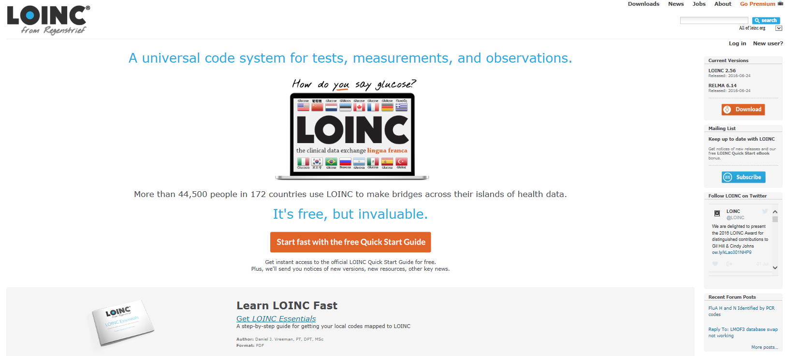
Vocabulary Standard Web Site – LRI-LIS
LOINC® Database version 2.50
http://loinc.org/

Slide 10
Lab Results to EHR-S Testing Process
HL7 LRI IG 2015
HIT Module LIS or EHR-S Lab Module
(System under Test)
Conformance Test Scope
EHR-S
ORU Message
ORU Elements
Message
Exported*
Direct Data Entry
NIST Test Tool (Validation Tool)
ORU Message Elements
Message
Imported*
Diagram does not show testing process for Acknowledgment messages
The HIT Module (e.g., LIS or EHR-S lab module) is the system being tested. The HIT Module is required to create messages that meet the conformance and vocabulary standards (See previous slides).
Test data can be entered into the Module directly via the user interface (manually) or can be imported via an incoming message (using any automated method).
The Module is expected to process the test data to create a message. This message is exported* from the Module and imported* into the NIST Test Tool for automated validation.
Test data are available through the Test Tool via the Test Steps. Each Test Step includes a Test Story that provides the context, a Test Data Specification that lists the test data, a Message Content Data Sheet that shows a conformant message (in a table format) including a detailed profile of the required elements, a Test Message, and (where applicable) a Juror Document.
*How the message is exported/imported/received is not in-scope for certification testing

Slide 11
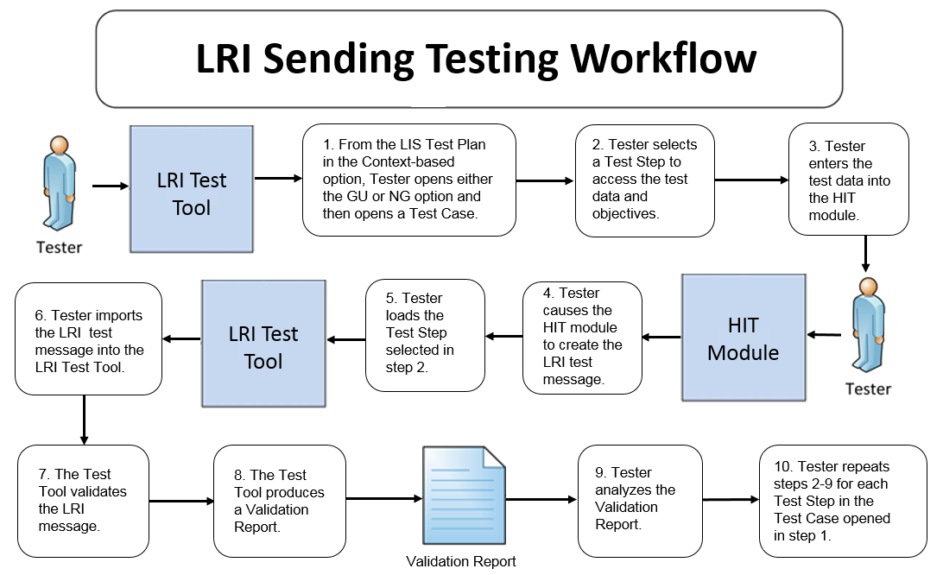
Transmit Lab Results Testing Workflow Diagram
This diagram shows
How the steps of the transmit lab test values/results test are sequenced
When the Test Tool is to be used

Slide 12
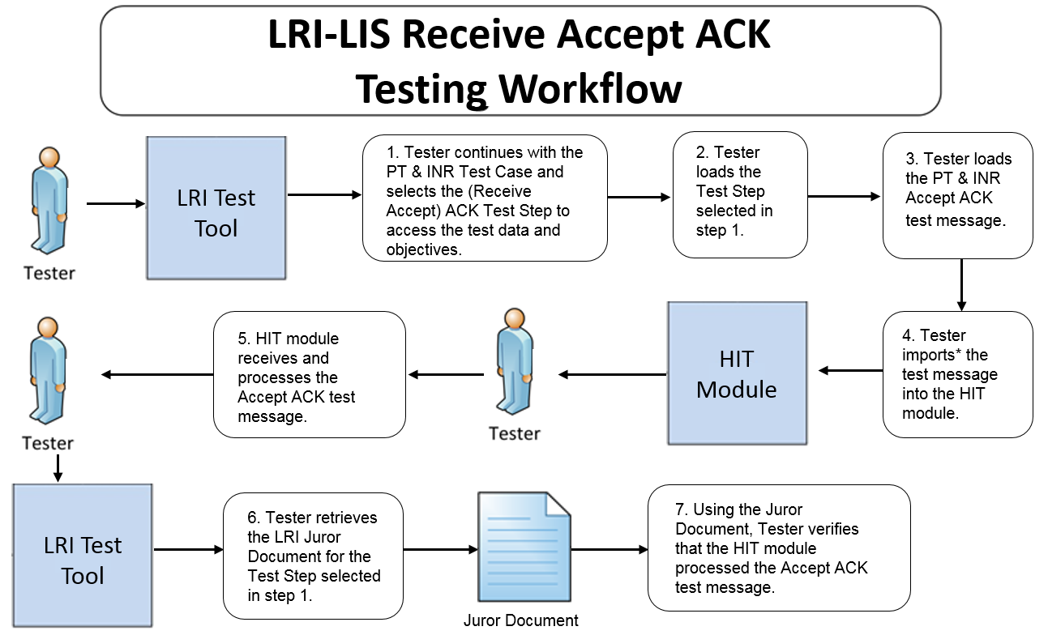
Receive Accept ACK Testing Workflow Diagram
This diagram shows
How the steps of the receive Accept Acknowledgement* test are sequenced
When the Test Tool is to be used
*Acknowledgement messages are tested only in the PT & INR Test Scenario

Slide 13
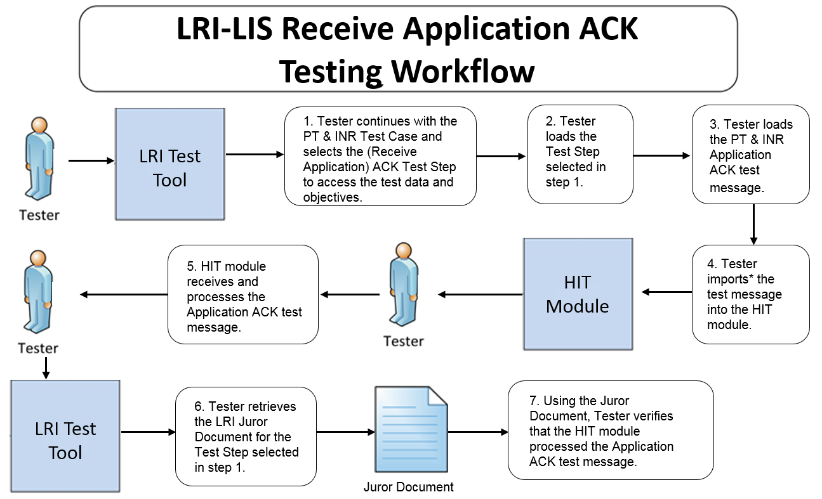
Receive Application ACK Testing Workflow Diagram
This diagram shows
How the steps of the receive Application Acknowledgement* test are sequenced
When the Test Tool is to be used
*Acknowledgement messages are tested only in the PT & INR Test Scenario

Slide 14
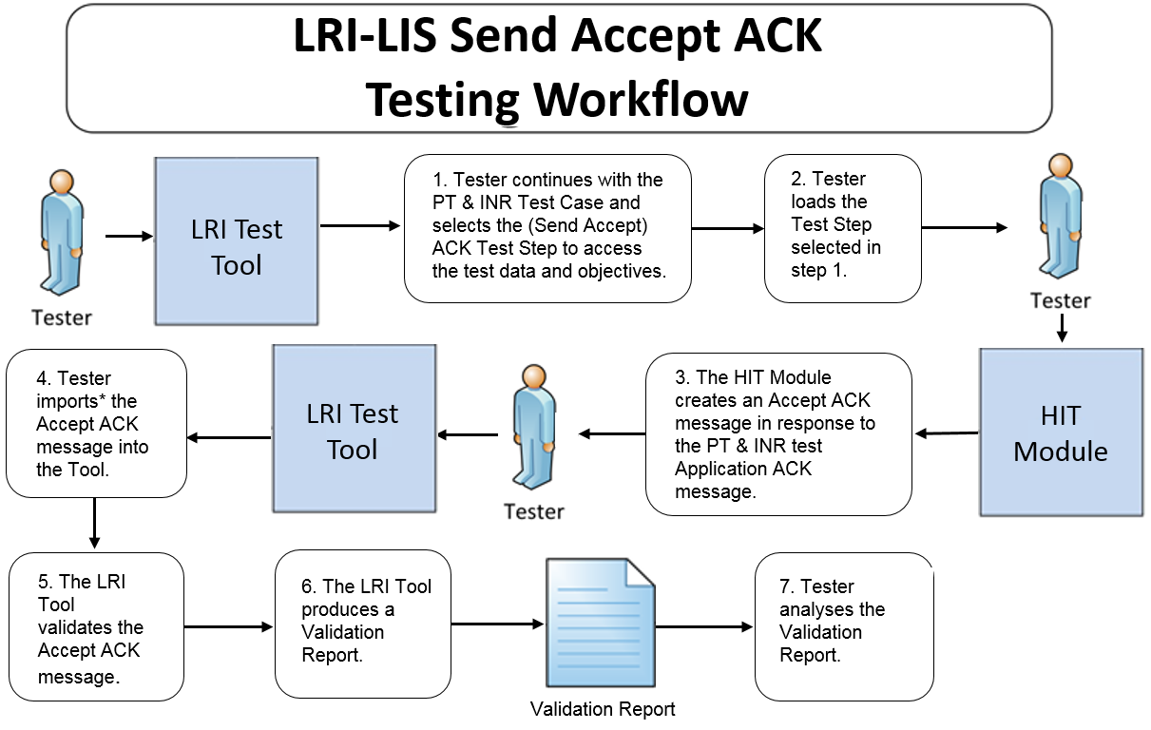
Send Accept ACK Testing Workflow Diagram
This diagram shows
How the test steps are sequenced for the send Accept Acknowledgement* message (in response to the Application Acknowledgement message)
When the Test Tool is to be used
*Acknowledgement messages are tested only in the PT & INR Test Scenario

Slide 15
Test Scenarios and Test Cases/Steps
Test data are available in the LRI Test Tool via the Test Scenarios provided in the LIS Test Plan
The Test Scenarios are composed of Test Cases and/or Test Steps
Each Test Step includes a Test Story, Test Data Specification, Message Content Data Sheet, Test Message, and (where applicable) a Juror Document
The HL7 Version 2.5.1 Implementation Guide: S&I Framework Lab Results Interface (LRI) interoperability standard defines four Profile options relevant for conformance testing:
LRI_NG_FRU_Profile – ID: 2.16.840.1.113883.9.195.3.3
LRI_NG_FRN_Profile – ID: 2.16.840.1.113883.9.195.3.4
LRI_GU_FRU_Profile – ID: 2.16.840.1.113883.9.195.3.1
LRI_GU_FRN_Profile – ID: 2.16.840.1.113883.9.195.3.2
The Tool provides seven Test Scenarios for the NG Profile options and seven for the GU Profile options
For the purpose of the testing, conformance to only one Profile option is required — the Vendor will inform the Tester as to which Profile option their HIT Module is conformant

Slide 16
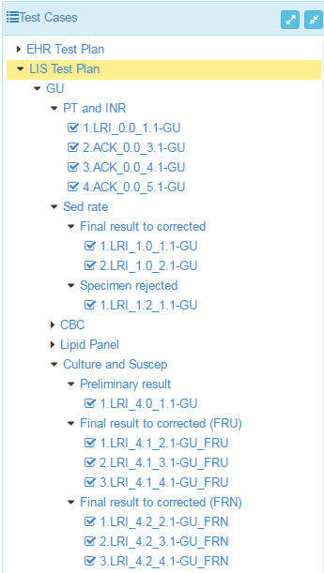
Test Scenarios and Test Cases/Steps (cont’d)
Test Scenarios/Cases/Steps for the four Profile options are provided in the LIS Test Plan in the LRI Test Tool
This figure shows a sub-set of the Test Scenarios/Cases/Steps in the LIS Test Plan for the GU Profile option
The Tester shall execute all seven Test Scenarios for either the GU or NG Profile
For certain Test Scenarios, the Tester need not execute optional* Test Cases
Profile option
Test Scenario
Test Step
Test Scenario
Test Case
Test Step
*Support for the capabilities in optional Test Cases is preferred but not required

Slide 17
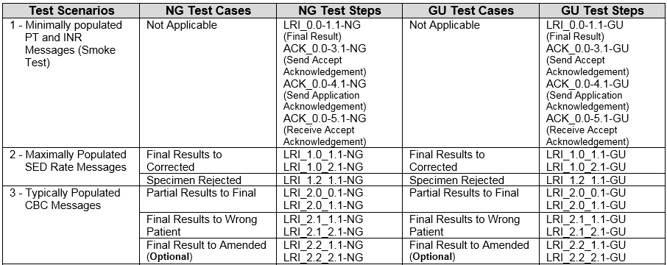
Test Scenarios and Test Cases/Steps (cont’d)
Test Cases/Steps for Scenarios 1 – 3 are shown in the table below
Minimally populated means the LRI example messages contain single occurrences of all required ("R") elements
Maximally populated means the LRI example messages contain all the R, RE, C(a/b) elements defined in the implementation guide
Typically populated means the LRI example message contains data that are routinely sent whether the data element is R (Required) or RE (Required, but may be empty)

Slide 18
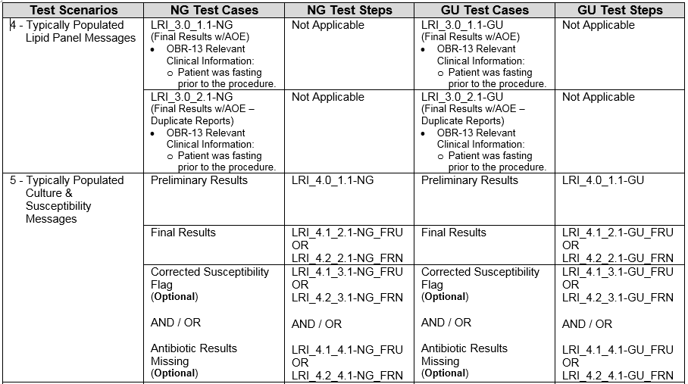
Test Scenarios and Test Cases/Steps (cont’d)
Test Cases/Steps for Scenarios 4 – 5 are shown in the table below

Slide 19
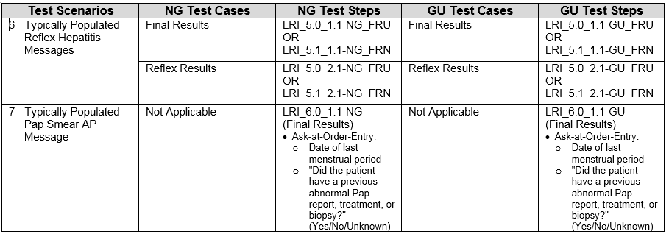
Test Scenarios and Test Cases/Steps (cont’d)
Test Cases/Steps for Scenarios 6 – 7 are shown in the table below

Slide 20
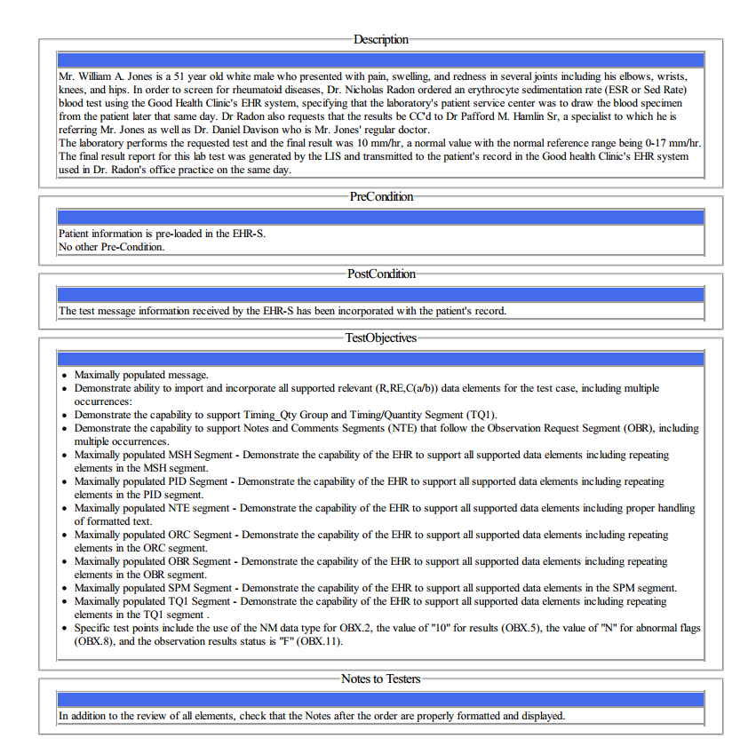
Test Data Documents* for Each Test Step
Test Story
Each Test Step includes a narrative Test Story that describes a real world situation and provides context for the Test Step
Along with the Test Story description is information about PreConditions, PostConditions, Test Objectives, and Notes to Testers
Example: Test Data pdf document for the LRI_1.0_1.1-GU_ Sed Rate Final Result Test Step
*Available for viewing online and via downloaded pdf or txt file

Slide 21
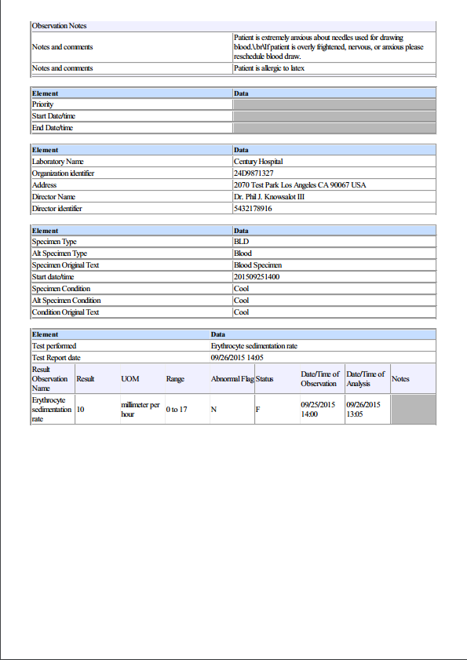
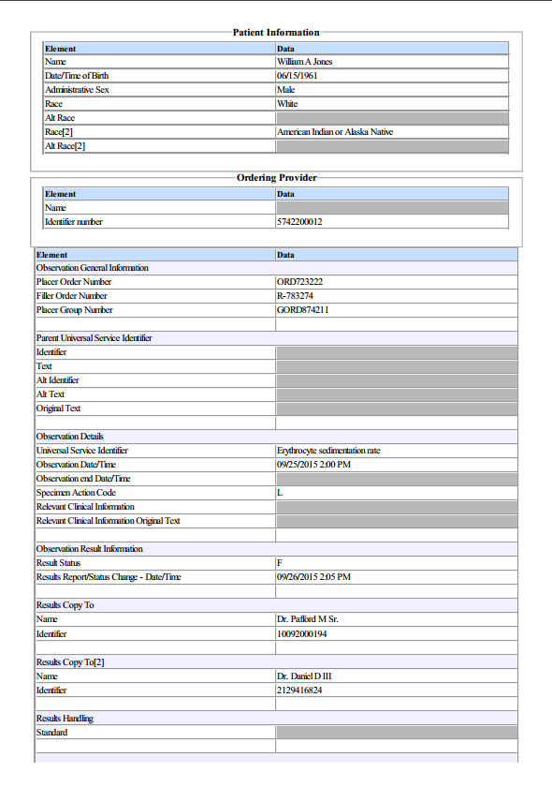
Test Data Documents for Each Test Step (cont’d)
Test Data Specification
Each Test Step includes a Test Data Specification that
Lists data associated with the Test Story
Consists of typical information found in the clinical setting
A test message is generated using these data and the HIT Module functions
Example: Test Data pdf document for the LRI_1.0_1.1-GU_ Sed Rate Final Result Test Step
21
Notes:
21

Slide 22
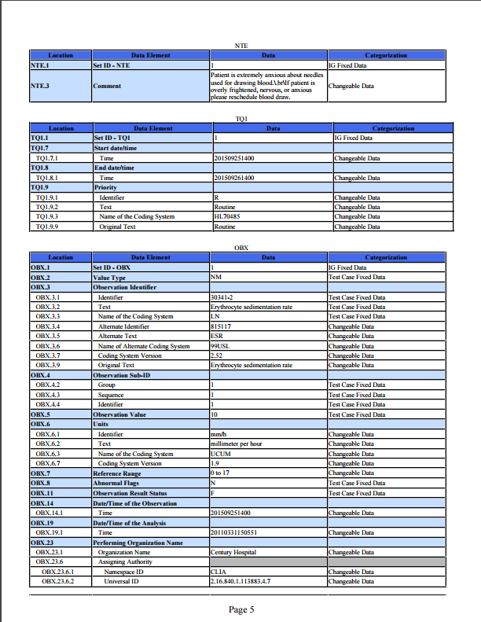
Test Data Documents for Each Test Step (cont’d)
Message Content Data Sheet
Each Test Step includes a Message Content Data Sheet that shows a conformant message instance
The category of the test data is listed in the Categorization column
The Categorization indicates how the data in the messages that are imported into the Tool are assessed by the validation engine
(See Test Data Categorization and Validation slides for more details)
Example: Test Data pdf document for the LRI_1.0_1.1-GU_ Sed Rate Final Result Test Step
22
Notes:
22

Slide 23
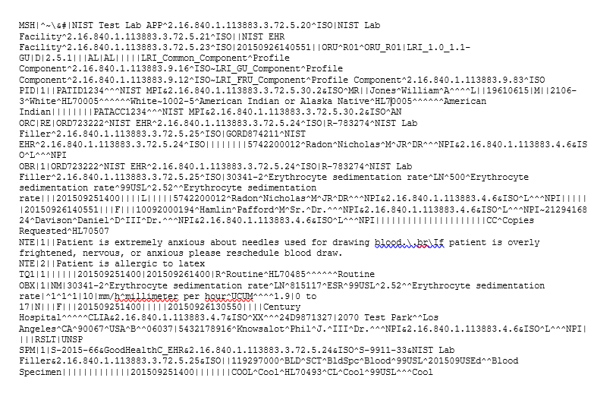

Test Data Documents for Each Test Step (cont’d)
Example Test Message
A test message is provided that coincides with the Test Story for the Test Step
For the LIS Test Plan
The lab result test messages are exported (sent) by the HIT Module being tested and are imported (received) by the LRI Test Tool (acting as the receiving EHR-S)
Two ACK messages are sent by the LRI Test Tool (acting as the receiving EHR-S) and are received by the HIT Module; and one ACK message is sent by the HIT Module and received by the LRI Test Tool
Example: Test Message for the LRI_1.0_1.1-GU_Final Sed Rate Test Step
Example: Test Message for the ACK_0.0_3.1-GU PT & INR Test Step

Slide 24
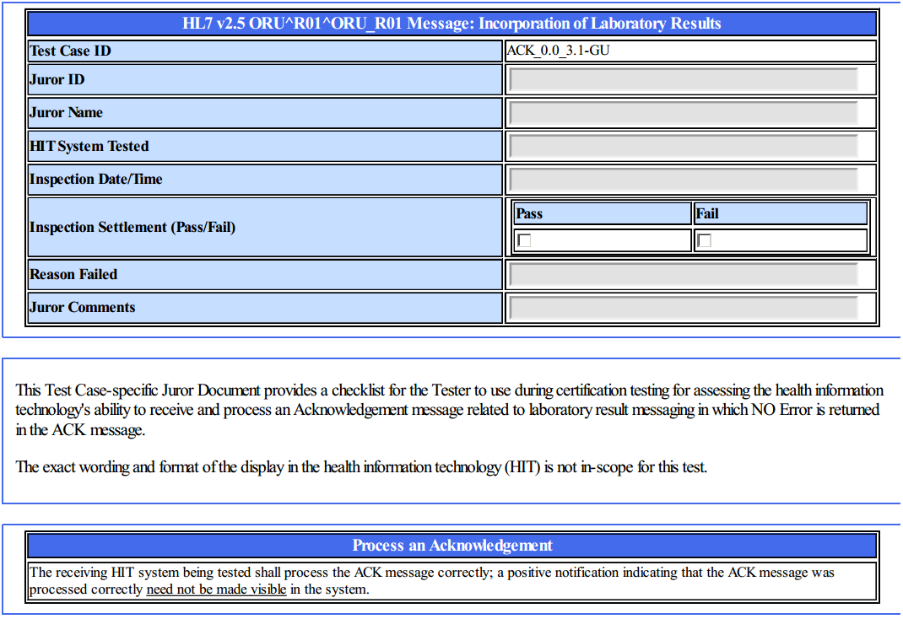
Test Data Documents for Each Test Step (cont’d)
Juror Document
Each (receiver) Test Step includes a Juror Document – a checklist used by the Tester/Inspector to assess and record whether the HIT Module processed the Acknowledgement message according to the LRI Implementation Guide
Example: Test Data pdf document for the ACK_0.0_3.1-GU PT & INR Test Step
24
Notes:
24

Slide 25
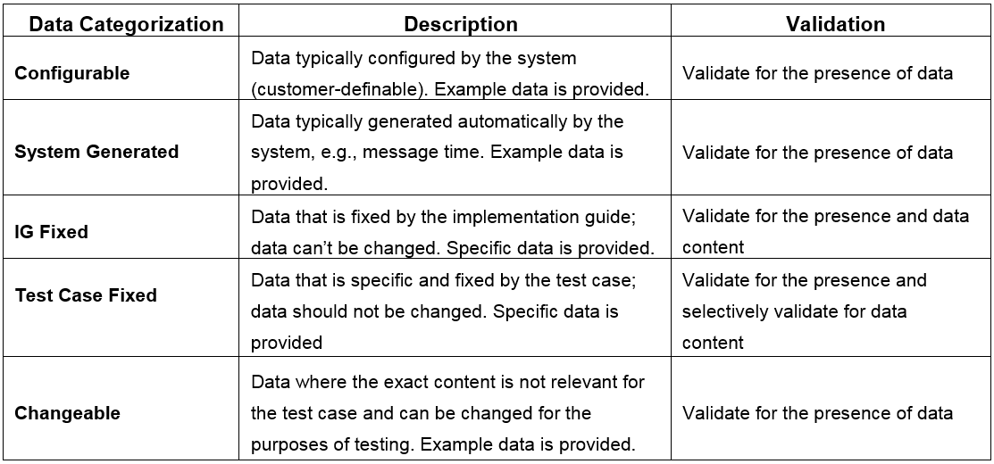
Test Data Categorization and Validation
The Message Content Data Sheet shows the categorization of the test data that are provided for each Location in the LRI message
The category assigned to the data is directly related to how the associated message content is validated by the Test Tool, as shown in the table below

Slide 26
Test Data Validation
The Test Tool validates a message for the presence and exact content of the data for Locations assigned to the IG Fixed category and for selective Locations assigned to the Test Case Fixed category
The Test Tool validates a message for the presence of data for Locations assigned to any of the other categories
These data are necessary for the transaction, but the exact content is either not relevant for the Test Step or may be system-dependent
Example: Universal ID for the Performing Organization
The Tester may also inspect the message during validation; the Inspection Test Guides in the Normative Testing Process Document provide guidance
Location | Value | Category | Assessment
OBX.3.1 | 30341-2* | Test Case Fixed Data | Content must be present and either “30341-2”, “18184-2”, “43402-7”, “4537-7”, “4538-5”, or “4539-3”
OBX.3.2 | Erythrocyte sedimentation rate | Test Case Fixed Data | Content must be present and indicate a value equivalent to Erythrocyte sedimentation rate
OBX.3.3 | LN | Test Case Fixed Data | Content must be present and exactly “LN”
OBX.23.6.2 | 2.16.840.1.113883.3.72.5.30.1 | Changeable Data | Content must be present and indicate an equivalent value
OBX.23.6.3 | ISO | IG Fixed Data | Content must be present and exactly “ISO”
*This option is provided in the Message Content Data Sheet for the LRI_1.0_1.1-GU Test Step

Slide 27
NIST LRI-LIS Test Tool Overview
Purpose: The tool validates LRI messages created by HIT Modules and is intended to be used for conformance testing according to the standards listed on the Conformance Standards page of this slide set
Tool Key Capabilities
Context-based testing / LIS Test Plan | Used for conformance testing driven by test data Validates HIT Modules that create HL7 messages in accordance with the ONC S&I Framework Lab Results Interface (LRI) implementation guide (IG) Provides Juror document for inspection testing
Profile Viewer | Provides a browse-able version of the conformance profile that encapsulates the requirements. Profile Viewer tab is accessible in Context-based testing once a Test Case or Test Step is “loaded”. Can be used to assist in the interpretation of message errors.
Value Sets Browser | Provides a browse-able view of the Value Sets and Vocabulary requirements. Value Sets tab is accessible in Context-based testing once a Test Case or Test Step is “loaded”. Can be used to assist in the interpretation of value set errors.
Documentation | Provides access to documents that assist in using the Tool for conformance testing (including the NIST Normative Test Process Documents, Implementation Guides, and Release Notes).
No registration or log-in credentials are required. Simply click on the link below to access and use the Tool
NOTE: The Test Tool (.war file) can also be downloaded and installed locally.
NOTE: Web Application is compatible with Firefox, Chrome, or Safari. Recommended browsers are Firefox and Chrome.
Register to Google Group at: https://groups.google.com/d/forum/hl7v2-lab-testing to ask questions and provide feedback.
http://hl7v2-lab-r2-testing.nist.gov/lri-r2/#/cb

Slide 28
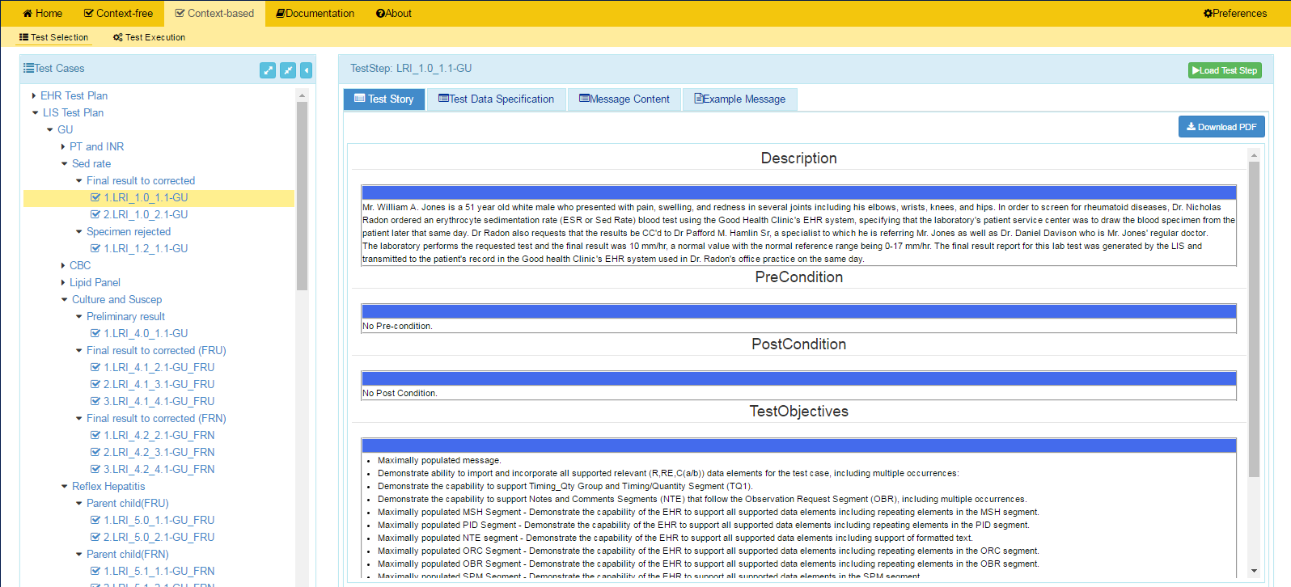
NIST LRI-LIS Test Tool Screen Shot
1
Open LRI Validation tool using link:
and click on Context-based
http://hl7v2-lab-r2-testing.nist.gov/lri-r2/#/cb
2
Test Selection view of page displays.
3
Click on arrow to open LIS Test Plan.
4
Click on arrows to expand the Test Scenarios and Test Cases. Click on a Test Step.
5
Test Step Title and Test Story tab display.
6
Click Message Content tab to view and download the Message Content Sheet.
HIT Context-based Validation
This feature is used to test HIT Modules for conformance to the LRI standards. The majority of the validation involves automated testing that assesses the LRI messages created by the Module and sent to the EHR-S Test Harness. Another type of validation pertains to the inspection testing. This process utilizes an inspector to ascertain if the Acknowledgement messages created by the EHR-S Test Harness are processed correctly by the Module. The Juror Document guides the inspector through the assessment process.
7
Click on Load Test Step button to proceed with conformance testing for the Test Step

Slide 29
Resources
Test Tool Web Site http://hl7v2-lab-r2-testing.nist.gov/lri-r2/#/home provides
Test Tool (API, Web Application, and Desktop)
Test Cases/Steps, Test Stories, Test Data, Message Content Sheets, Example Messages, Juror Documents
User Documentation
Testing Artifacts
Message Profiles
Value Sets
Validation Reports
Contact
Rob Snelick (rsnelick@nist.gov)

